Slide 1
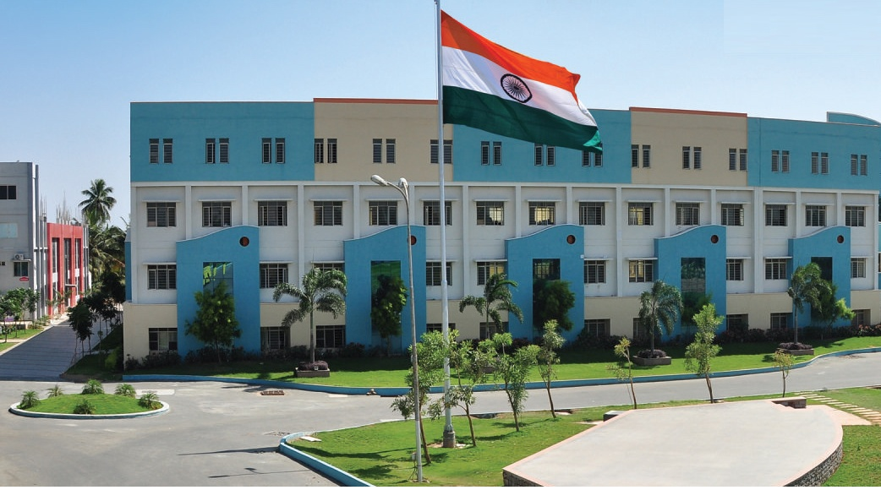
SRI ESHWAR COLLEGE OF ENGINEERING academic year: 2017-18 department: civil engineering
DESIGN PROJECT first review
Date of review:02.08.2017

Slide 2
PLANNING, ANALYSIS & DESIGNING OF SHOPPING MALL
BATCH MEMBERS
MEKHALA.K
PREETHI.V.J
CHANDRU. M
NIVETHA.S
Guide Name
Mr. Raaj Kumar .S
Asst. Prof/Civil Dept.

Slide 3
Presentation Outline
This presentation gives a detailed outline about
Abstract of the project
Objectives
Literature Survey
Plan of the project
Need for the study
Methodology

Slide 4
Abstract of the project
This project is about planning, analysis and designing of a shopping mall of G+3 storey with underground parking and investigate its performance under various loading conditions.
The planning of the shopping mall is done by Auto CAD, Analysis and designing is done manually as well as in STAAD Pro. The 3D analysis is done in Google SKETCHUP and Revit Architecture.
Current Indian standards design practices which will ensure sufficient level of safety for various levels of loading demands.

Slide 5
Specifications
Shopping mall
Location : Pollachi
Built up area : 1,05,000 sq. ft
Number of stores : 80
No. of storeys : Basement+G+3

Slide 6
Indian Standard Codes Used
IS800:2007
IS456:2000
IS875:1987 (PART 1, PART 2, PART 3, PART 4 and PART 5)

Slide 7
Literature Survey (Cont’d..)
JOURNAL | International Journal of Engineering Science Invention
TITLE | Analysis and Design of Shopping Malls against lateral forces
AUTHOR(S) | Sonia Longjam , S.Aravindan
INFERENCE | The various parameters to be considered while designing and analyzing by seismic coefficient method and necessary requirements as per BIS specifications as well as various Indian standard code specifications has been incurred in the journal.

Slide 8
JOURNAL | International Journal of Modern Engineering Research
TITLE | Seismic Analysis of RCC Buildings with or without shear walls
AUTHOR(S) | Chandurkar P.P, P.S. Pajgade
INFERENCE | Plan using AutoCAD, Modeling and analysis by seismic coefficient method for the buildings with or without shear walls are presented in the paper.
TITLE

Slide 9
JOURNAL | International Journal of Engineering Science Invention
TITLE | Comparative Study of The Effects of Wind and Earthquake Loads on High-Rise Buildings.
AUTHOR(S) | Magdy A. Tayel, Khaled M. Heiza
INFERENCE | The paper compares effect of the wind load and seismic load acting on the high rise buildings and ensure sufficient level of safety for various levels of loading demands
JOURNAL
International Journal of Engineering Science

Slide 10
JOURNAL | Journal of Retail and Leisure Property
TITLE | Growing shopping malls and behavior of urban shoppers
AUTHOR(S) | Rajagopal
INFERENCE | Based on the survey of urban shoppers, the study analyses the cognitive attributes of the shoppers towards attractiveness of shopping malls and intensity of shopping. The results of the study reveals the ambience of shopping malls, assortment of stores, sales promotions and comparative economic gains in the malls attract higher customer traffic to the malls
JOURNAL
International Journal of Engineering Science Invention
JOURNAL

Slide 11
JOURNAL | Journal of Business and Management
TITLE | Influencing factors and attractiveness of shopping mall to mall behavior of people in Jakarta
AUTHOR(S) | Ernest Hasiolan Sebastian, Mustika Sufiati
INFERENCE | Many factors of shopping mall considered by customers for choosing their favorite mall. Location of the shopping mall, mall shopping behavior are factors that make a shopping centre more attractive to customers.
.

Slide 12
JOURNAL | Journal of Structural Division
TITLE | Torsional Response of High Rise Buildings
AUTHOR(S) | Gary C.Hart
INFERENCE | Ambient and earthquake response records obtained in several southern California high- rise buildings are analyzed. Building translational and torsional natural periods are estimated and compared.

Slide 13
JOURNAL | Journal of Constructional Steel Research
TITLE | Experimental study on flexural performance of partially precast steel reinforced concrete beams
AUTHOR(S) | Yong Yang, Yicong Xue
INFERENCE | The analysis of mechanical behavior and the design method can be used for the design these innovative composite beams and provide a significant foundation for further research.

Slide 14
JOURNAL | Journal of Constructional Steel Research
TITLE | Seismic performance of steel plate reinforced concrete shear wall and its application
AUTHOR(S) | Bin Wang, Huanjun Jiang, Xilin Lu
INFERENCE | The modeling techniques with the aid of the software to simulate the hysteric behavior of shear walls are presented and validated by technical experimental results.

Slide 15
JOURNAL | Journal of Structural Division
TITLE | Load and Resistance Factor Design for Steel
AUTHOR(S) | Ting Raymond M.L
INFERENCE | The paper concerns itself with the background and the choice of the particular first-order model, with the data bases used in evaluating the loading and the resistance functions, the choice of the safety index, and with the final selection of the load and resistance factors.

Slide 16
JOURNAL | International Journal of Engineering
TITLE | Shear in beam – column joints in seismic design of steel frames
AUTHOR(S) | H . Krawlinker
INFERENCE | Effects of high shear joints on the strength, stiffness and energy dissipation characteristics of frames are discussed. Solutions for the ultimate shear strength, associated with controllable inelastic distortions, are given, for joints with unreinforced and reinforced webs.

Slide 17
Sectional plan of Basement

Slide 18
Sectional plan of Ground floor

Slide 19
Sectional plan of First floor

Slide 20
Sectional plan of Second floor

Slide 21
Sectional plan of Third floor

Slide 22
Cross Sectional plan

Slide 23
Elevation view

Slide 24
Need for the study
To provide a platform for marketing and Recreational activities in a multi-disciplinary manner.
To be constructed in Evergreen environment, near Pollachi improving Tourism in a modernized eco friendly manner.
Aesthetic shopping mall with a modern facilities and easy convenience for urban shoppers with a steel roof surface with seismic resistance.

Slide 25
Methodology
Topic selection
Basic planning of project
Data collection
Literature study
Planning using Auto CAD
Analysis using Staad Pro.
3D Modelling using Google SKETCH UP or Revit Architecture
Submission of Report

Slide 26
Work Schedule
S.NO | DATE | WORK TO BE DONE | REMARKS
1 | 20.04.2017 | Selection of Topic | .
2 | 07.07.2017 | Collection of literatures | .
3 | 02.08.2017 | Planning of building | .
4 | 19.08.2017 | Analysis and design using STAAD.Pro | x.
5 | 18.09.2017 | Completion of project | .
6 | 28.09.2017 | Submission of Book | .

Slide 27
queries?
Thank you

